Slide 1
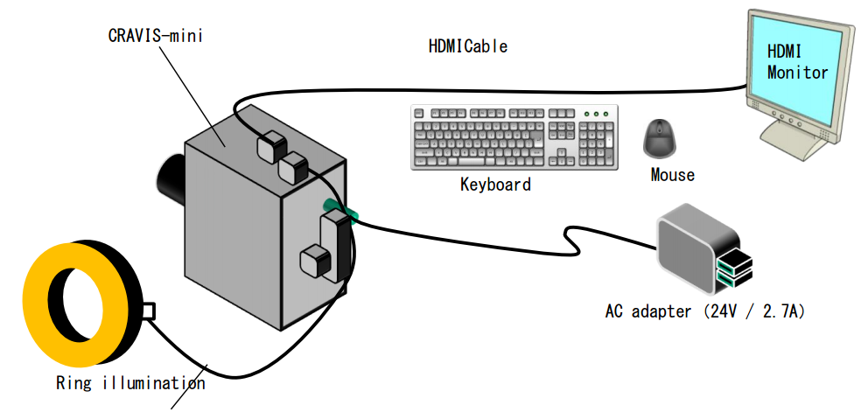
Rubber Check Investigate Result
(Using Cravis mini)
I
Overview
II
Investigate result
III
Next plan
IV
Schedule
PIC : Visual Group
Dept: AED

Slide 2
I. OVERVIEW
1.1. Purpose of project
Check direction of rubber
Combine with others unit ➔ Auto system
Target : Auto check after assembly
New strategy : Using Cravis mini to check
1.2. Concept
1
2
3
4
Lamp
Roller
Pi Camera
Rubber

Slide 3

I. OVERVIEW
1.2. Concept
Pi Camera
Cycle time of machine : 6s/pcs
Time check of Cravis : 3s/pcs
$${90}^{0}$$
100-300 mm
50-200 mm
Pi Camera
100-300 mm
50-200mm

Slide 4
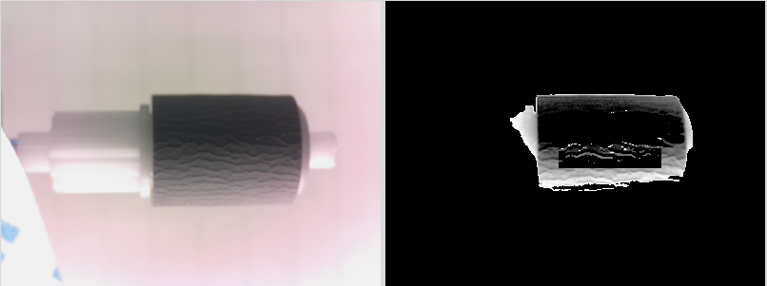
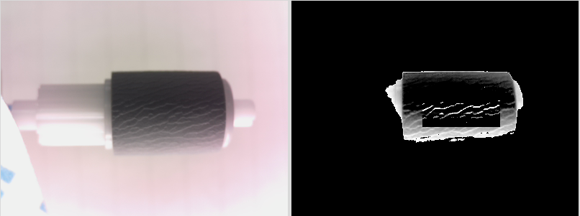
II. INVESTIGATE RESULT
2.1. Algorithm for checking
Extract Color ( Filter Color )
White Balance
Particle (Using to searching abnormal points)
0
255
Average – threshold
Average
Average + threshold
Convert to black
Keep color
Convert to white
NG
Count Pixel
NG pcs : 32- 75 (pixel)
OK pcs : 160-325 (pixel)
! This is only Test Data (investigate room)
OK

Slide 5
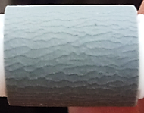
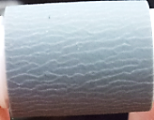
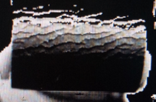
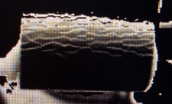
II. INVESTIGATE RESULT
2.2. Result (300pcs)
Sample Item check | Picture
 | NG sample | OK sample
Origin
Analyzed
Check Result | NG (Count pixel : 32-75) | OK (Count pixel : 160-325)

Slide 6
III. NEXT PLAN
3.1. Current system
Good point
Hardware : small → easy to layout
Software :
same with EOS program → familiar
same with industrial Camera Program
→ simple, convenient, easy make new program and setup spec file
Blur
Need improve point
Program : simple →Need add more algorithms
Only check simple function →Improve to check complex function
3.2. Next plan
Test with many project
3.2.1 PCB
3.2.2 MOLD
3.2.3 ASSY

Slide 7
IV. SCHEDULE
Work content | Mar |  |  |  |  |  |  |  |  |  |  |  |  |  |  |  |  |  |  |  |  |  |  |  |  |  |  |  |  |  |  | Apr
 | 1 | 2 | 3 | 4 | 5 | 6 | 7 | 8 | 9 | 10 | 11 | 12 | 13 | 14 | 15 | 16 | 17 | 18 | 19 | 20 | 21 | 22 | 23 | 24 | 25 | 26 | 27 | 28 | 29 | 30 | 31
Test rubber (500 pcs) |  |  |  |  |  |  |  |  |  |  |  |  |  |  |  |  |  |  |  |  |  |  |  |  |  |  |  |  |  |  |  | PCB
Setup in line
Take Data
Debug
Test 1st
Test 2nd
Test 3rd
Apply

Slide 8
Thanks you for your attention
and valuable questions

